Slide 1
Convocation:
What to expect
4:00-4:30 whole group Kennedy
4:30-5:15 meet the Departments see map
5:15-6:00 meet the student clubs Kennedy
pizza & prizes

Slide 2
Key points from those who know
You have to get advised before you can register for classes.
Don’t ever park backward in a parking spot.
Don’t be afraid to ask questions.

Slide 3
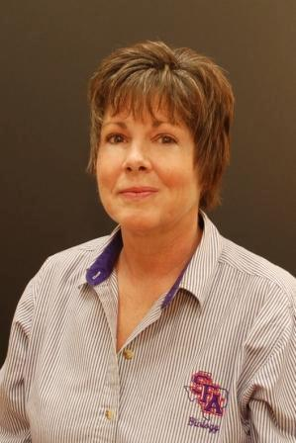
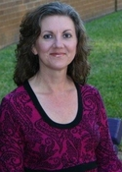
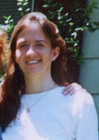
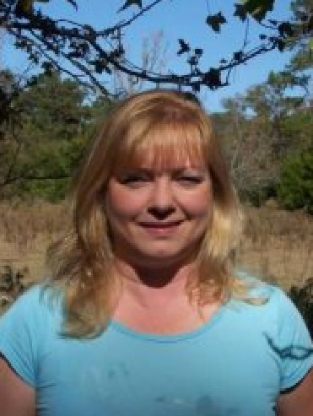
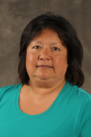
If you don’t know your advisor…
Laura Anderson,
Biology
Carrie Stover, Chemistry & Biochem
Donna Rocka,
Computer Science
Shawna Scott,
Geology
Judeana Marshall,
Math & Statistics
Rosemary Juarez,
Nursing
Kelly Kahlden,
Physics & Astronomy

Slide 4
Key points from those who know
You have to get advised before you can register for classes.
Don’t ever park backward in a parking spot.
Don’t be afraid to ask questions.

Slide 5
Key points from those who know
You have to get advised before you can register for classes.
Don’t ever park backward in a parking spot.
Don’t be afraid to ask questions.

Slide 6
College Tailgate

